Slide 1
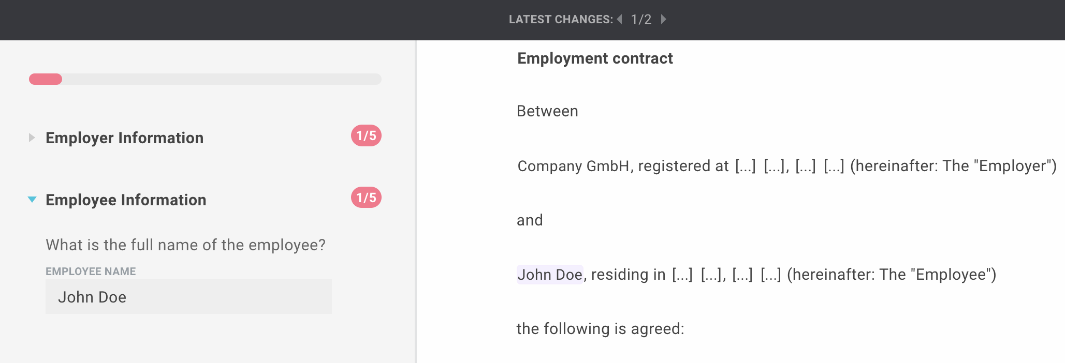
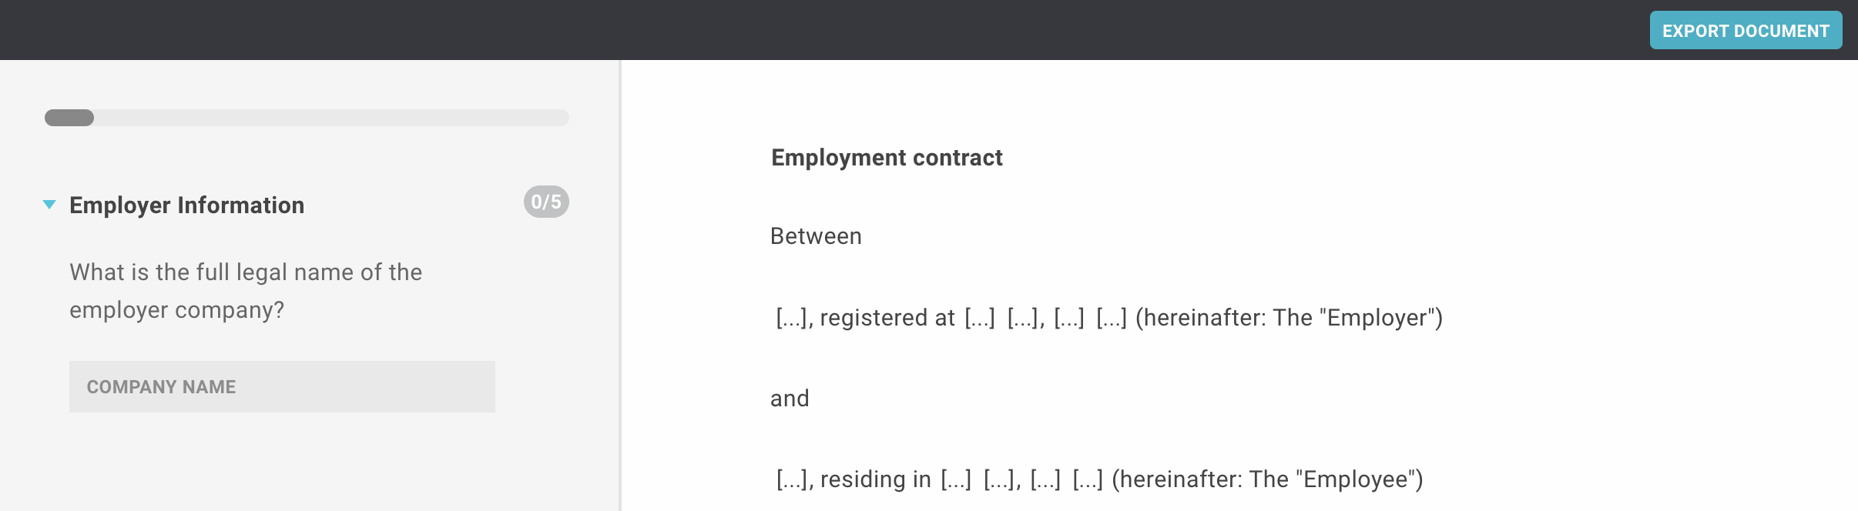
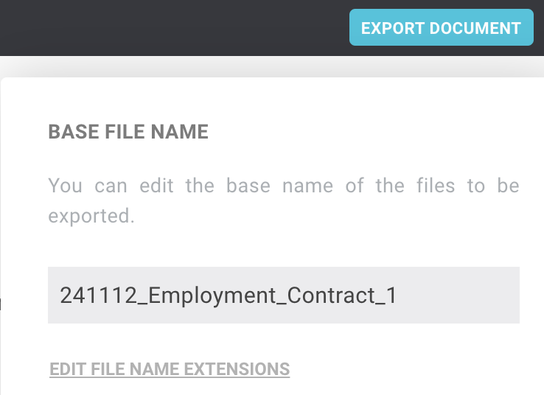
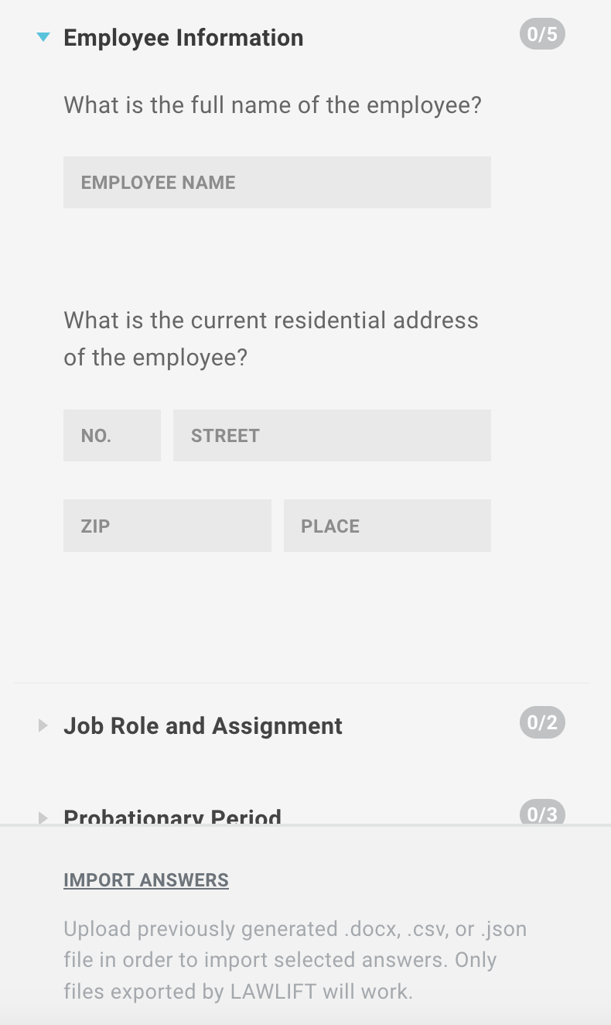
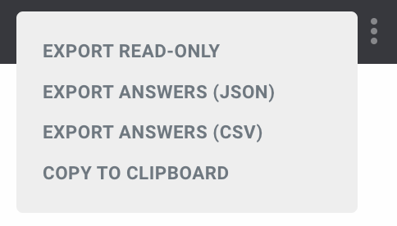

Cheat Sheet - Publications
1. Click on the red marked link of the template you want to use.
2. The template opens in your browser.
3. Track changes.
Here you could then insert a screenshot of your intranet, for example, where you outline the link to be clicked on in red.
On the left-hand side you will see the questionnaire, on the right-hand side the contract text. At the top right you will see the export button.
Now start filling in the questionnaire. You can track your changes live on the right-hand side.
When you answer questions, you can see the effects of the answers in the top bar. Simply click on the arrows to see all the changes in the document.
4. Export your result.
5. Influence export.
6. Import answers.
If you hover over the "Export document" button for longer, you can change the name of the file to be exported.
If you have already created a document with data that you would like to reuse, you can import answers.
To do this, you can either upload an exported Word document or the answers in CSV or JSON format. Simply click on "Import answers" and select the desired file.
Please note! You can only import responses that have been created using the same template.
You can tell whether you have answered all the questions by the display at the top left of the questionnaire and by the indicators behind the respective question section.
Once you have completed the questionnaire, you can download your results by pressing the "Export document" button at the top right. You will receive a fully formatted DOCX file.
You can use the three dots to show additional export functions. For example, you can export only the answers or copy the content of the document to the clipboard.

